Slide 1
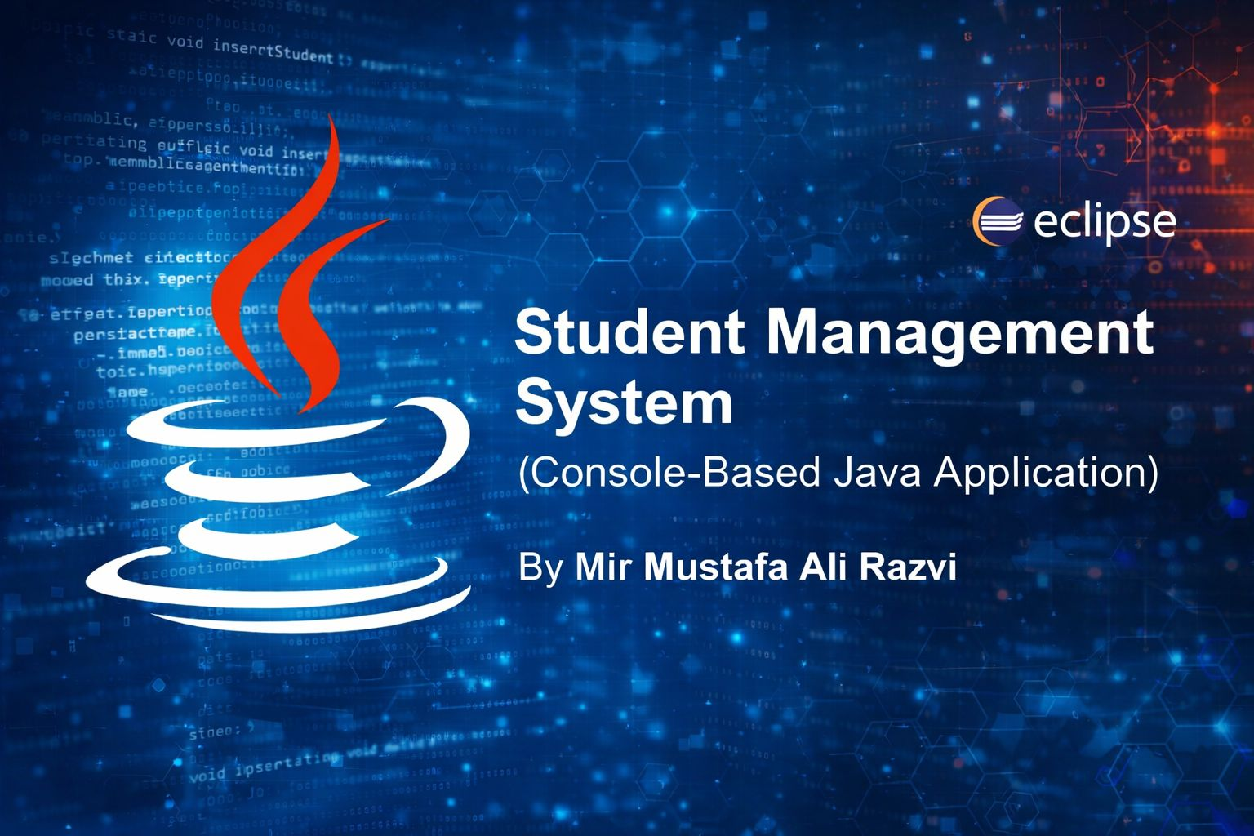

Slide 2

Project Introduction The Student Management System is a console-based Java application designed to manage student records efficiently. It allows users to: •Add student details •View all students •Search students by ID This project is developed using Core Java and demonstrates the use of Object-Oriented Programming concepts through a menu-driven console interface.

Slide 3

Project Overview
Developed a console-based Student Management System using Java
The application allows basic management of student records
Designed to apply Object-Oriented Programming (OOP) concepts in a real scenario
Menu-driven system for easy interaction

Slide 4

Objectives
To strengthen understanding of Core Java
To implement Object-Oriented Programming concepts
To perform basic operations like adding, viewing, and searching , student data
To gain hands-on experience in building a complete Java application

Slide 5


Key Features
Add new student details
View all student records
Search student details using Student ID
Menu-driven console interface
Simple and structured program flow
Technologies Used
Java (Core Java)
Eclipse IDE
Other Tools
GitHub (for source code management)

Slide 6
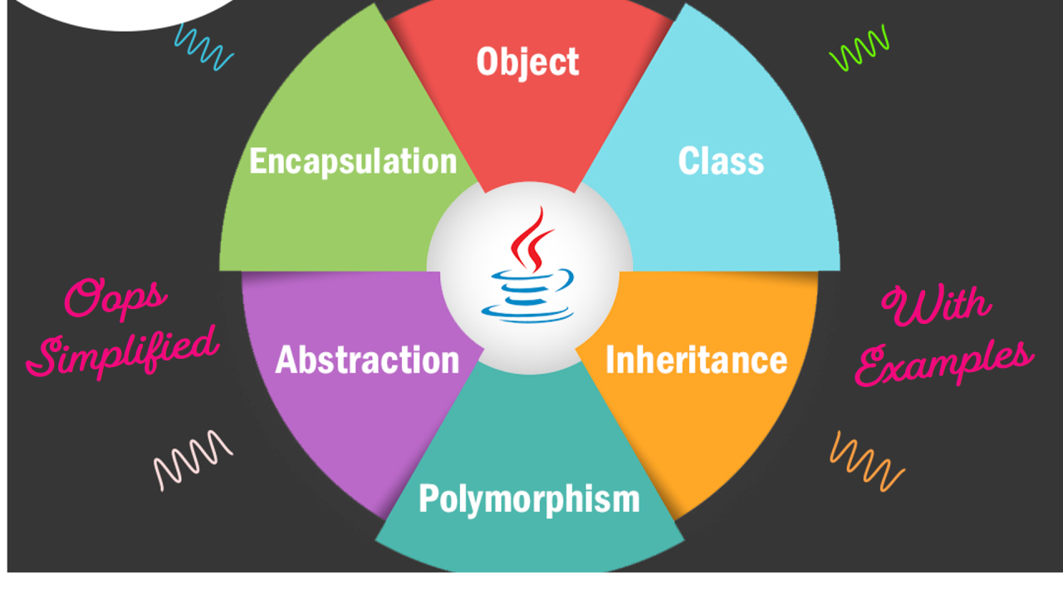
Object-Oriented Concepts Used
Encapsulation
Data members are protected using access modifiers
Data is accessed through constructors and methods
Inheritance
Student class extends the Person class
Basic Polymorphism
Method usage through class hierarchy
(Concepts are implemented at a beginner-to-intermediate level)

Slide 7

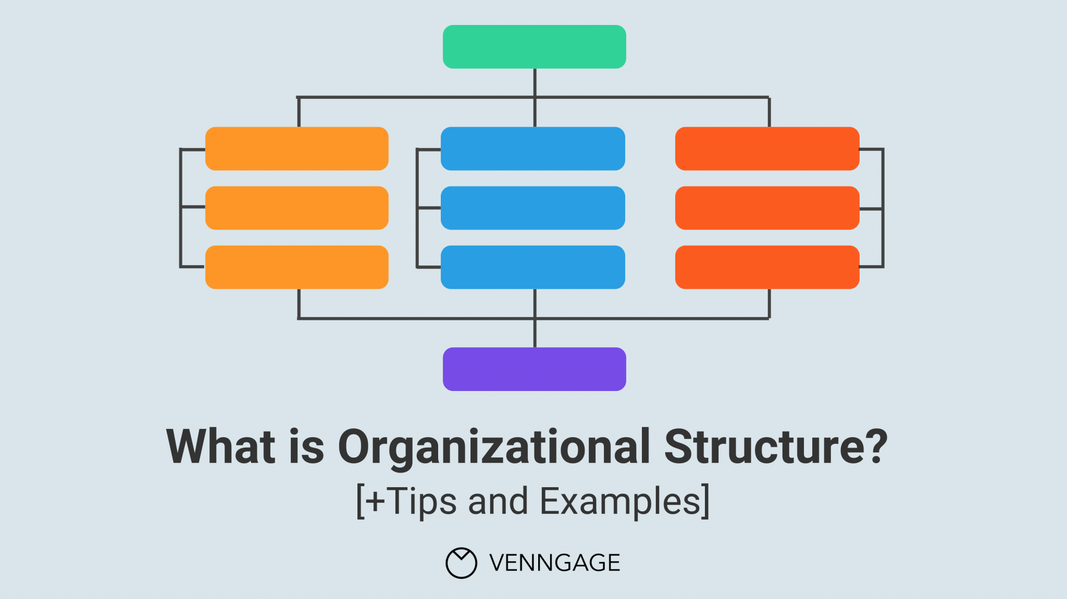
Project Structure
Main.java
Handles menu options and program execution
Person.java
Base class containing common attributes
Student.java
Derived class representing student details
StudentService.java
Contains logic for add, view, and search operations

Slide 8
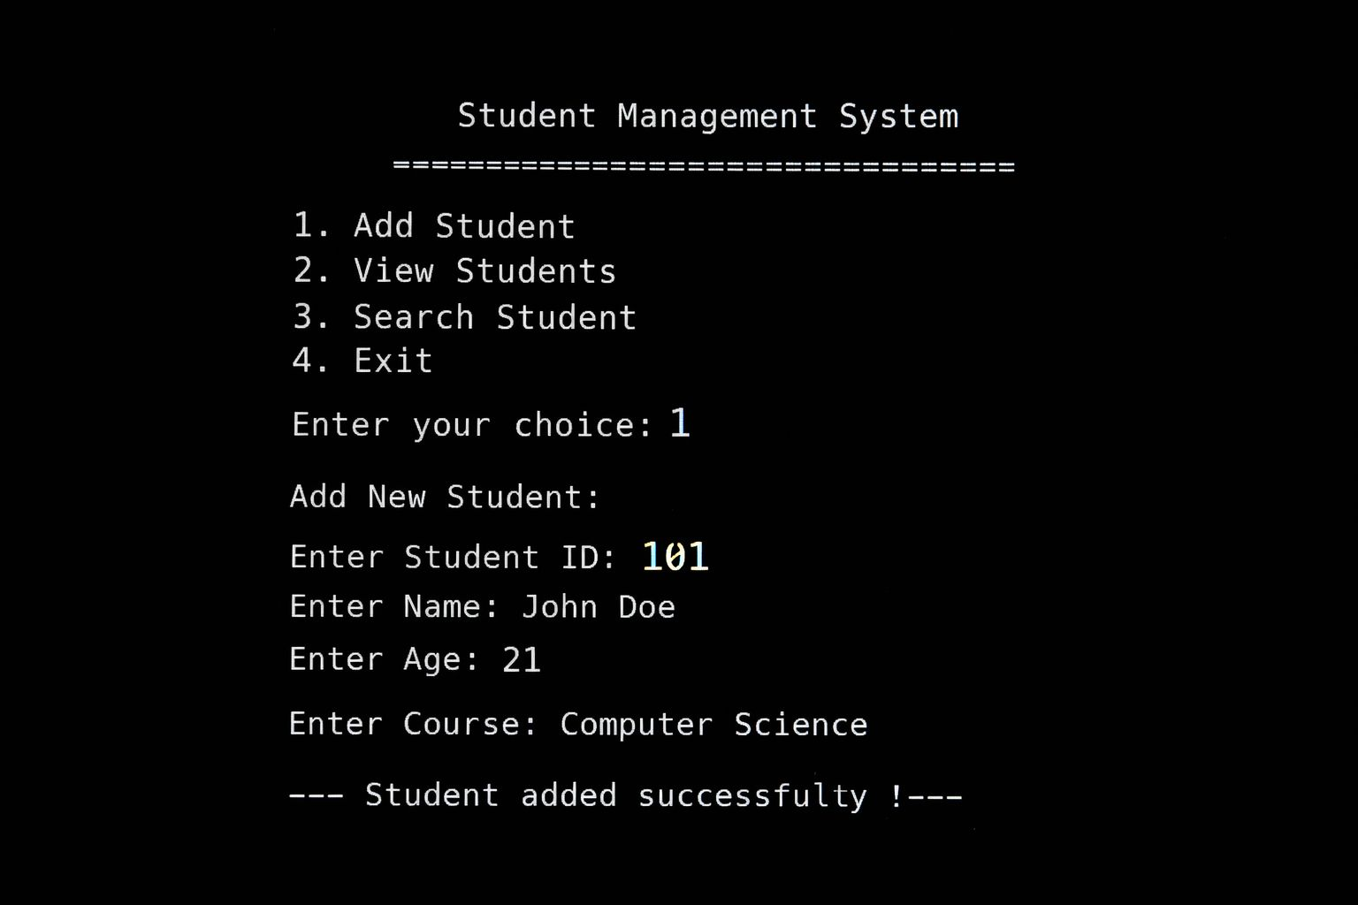
Add Student Functionality
User selects option 1 – Add Student
Enters:
Student ID
Name
Age
Course
Student data is stored successfully

Slide 9
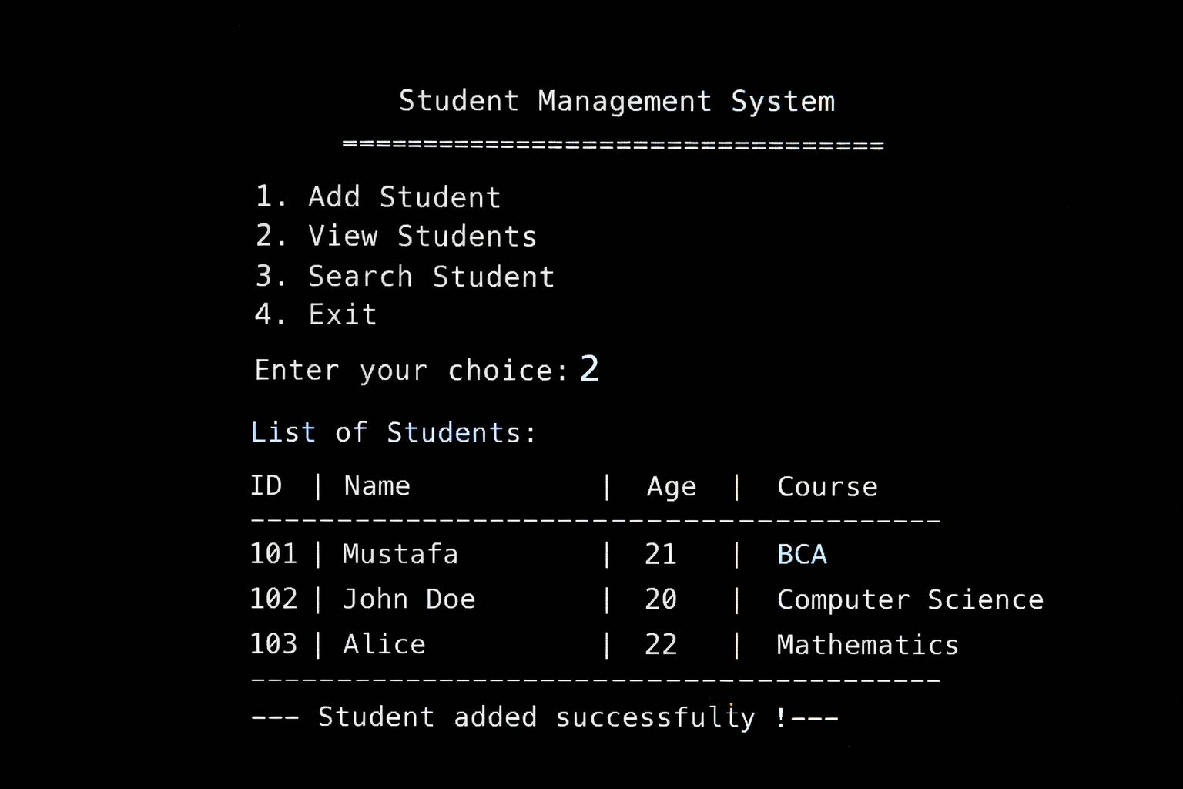
View Students Functionality
Displays all added student records
Shows:
Student ID
Name
Age
Course

Slide 10
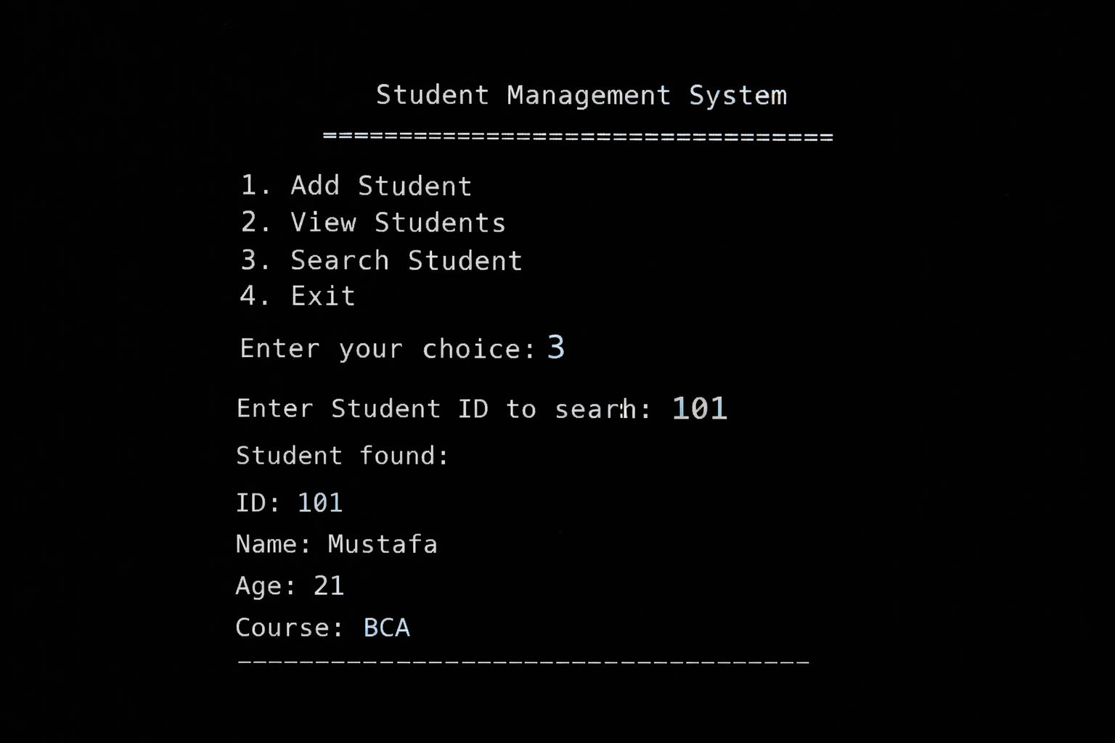
Search Student Functionality
Search is performed using Student ID
Displays matching student details
Helps in quick retrieval of data

Slide 11

Learning Outcomes
Improved understanding of Java fundamentals
Practical implementation of OOP concepts
Learned how to structure multi-class Java projects
Gained experience in debugging and logic building

Slide 12

Conclusion
The Student Management System successfully meets the project objectives
The project helped in strengthening Java and OOP fundamentals
It serves as a foundation for future enhancements such as database or GUI integration

